Slide 1
Non-Slicing Floorplanning
Joanna Ho
David Lee
David Omoto

Slide 2
Overview
Introduction
Sequence-Pair Representation
O-Tree Representation
Generalized Polish Expression (GPE)
Summary

Slide 3
Introduction
Problem: Given a set of rectangular modules of arbitrary sizes, place them without overlap on a plane within a rectangle of minimum area
Motivation
  Slicing floorplan may not produce optimal solutions, i.e., minimum area
  Reduce interconnect delay
  Cost (chip area) savings
Difficulties
  NP-complete
  Need good representation of non-slicing floorplan
  Larger solution space and encoding cost

Slide 4
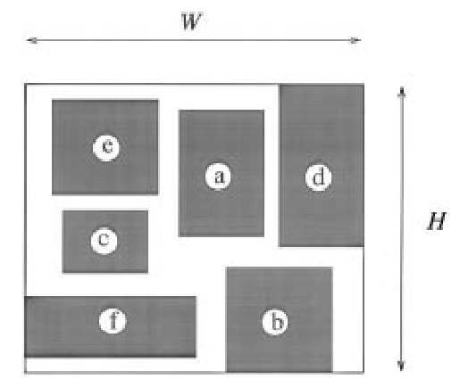
Floorplanning with Sequence-Pairs
Definitions:
packing = non-overlapping placement of the modules
chip = minimum bounding rectangle of a packing with height (H) and width (W)
solution space: a set of codes, each representing a construction of a placement
A code is feasible if the construction is consistent, i.e., there exists a packing corresponding to the code

Slide 5
Floorplanning with Sequence-Pairs
RP is a combinatorial search using simulated annealing to find the best code (minimum area) in the solution space
Minimum requirements of the solution space
    Solution space is finite
    Every solution is feasible (allows the use of heuristics such as SA)
    Realization of a code is possible in polynomial time
    There exists a code which corresponds to one of the optimal solutions
P-admissible solution space if all four requirements are met

Slide 6
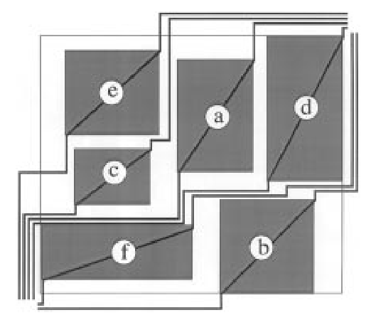
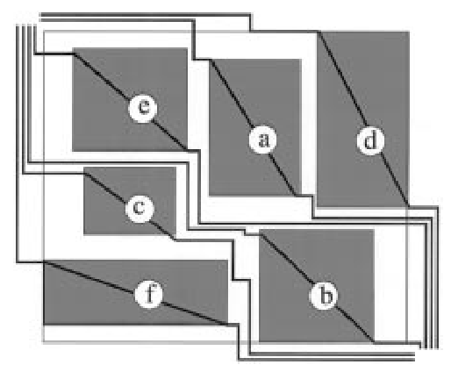
From a Packing to a Sequence-Pair
A sequence-pair is an ordered pair of module name sequences (codes)
Gridding encodes a packing into a sequence-pair
  The following rules must be satisfied:
    Step-lines cannot cross:
      Boundaries of other modules
      Previously drawn lines
      Boundary of the chip
up-right
left-up
down-left
right-down
Positive step-lines
Negative step-lines

Slide 7
Gridding
Since no two positive step-lines cross each other, they can be linearly ordered
  Therefore, the corresponding modules can be linearly ordered
  Let Γ₊ be the module name sequence ordering from the left
    Ex.) Γ₊ = ecadfb
Likewise, negative step-lines and modules can be linearly ordered
  Let Γ₋ be the module name sequence ordering from the left
    Ex.) Γ₋ = fcbead
Modules x and x’ are related in exactly one of four ways:
  M^{aa}(x) = { x’ | x’ is after x in both Γ₊ and Γ₋ } Ex.) M^{aa}(c) = { a, b, d }
  M^{ab}(x) = { x’ | x’ is after x in Γ₊ and before x in Γ₋ } Ex.) M^{ab}(c) = { f }
  M^{ba}(x) = { x’ | x’ is before x in Γ₊ and after x in Γ₋ } Ex.) M^{ba}(c) = { e }
  M^{bb}(x) = { x’ | x’ is before x in both Γ₊ and Γ₋ } Ex.) M^{bb}(c) = { }
x’ ε M^{aa}(x) ⬄ x ε M^{bb}(x’) and x’ ε M^{ba}(x) ⬄ x ε M^{ab}(x’)

Slide 8
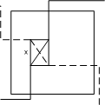
Information of the Sequence-Pair
Let (Γ₊,Γ₋) be the sequence-pair produced by Gridding for a packing II
    If x’ ε M^{aa}(x), then x’ is right of x in II
    If x’ ε M^{ab}(x), then x’ is below x in II
    If x’ ε M^{ba}(x), then x’ is above x in II
    If x’ ε M^{bb}(x), then x’ is left of x in II
  Proof:
    Let x and x’ be two arbitrary modules in II. Then the step-lines of x divide the chip up into four regions, called the right-cone, left-cone, above-cone, and below-cone.

Slide 9
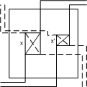
Information of the Sequence-Pair
Let (Γ₊,Γ₋) be the sequence-pair produced by Gridding for a packing II
    If x’ ε M^{aa}(x), then x’ is right of x in II
    If x’ ε M^{ab}(x), then x’ is below x in II
    If x’ ε M^{ba}(x), then x’ is above x in II
    If x’ ε M^{bb}(x), then x’ is left of x in II
  Proof:
    Suppose x’ is in M^{aa}(x). Then the positive step-line of x’ is in the union of the right-cone and the below-cone of x. Also, the negative step-line of x’ is in the union of the right-cone and the above-cone of x.
    The crossing point of the positive and negative step-lines of x’ is in their intersection, i.e. the right-cone of x. Therefore, module x’ is in the right-cone of x.
    Thus, every modules in the right-cone of x is right of module x by definition of the up-right step-line and the right-down step-line of x.
    The same proof can be applied to the other cases.

Slide 10
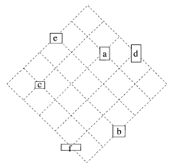
From a Sequence-Pair to a Packing
Gridding produced a sequence-pair from a specific packing. A packing is now produced from an arbitrary sequence-pair.
The constraint imposed on the packing by a sequence-pair is unique.
d
a
Γ₋
e
b
c
f
Expand grid lines so
no overlapping occurs
e
c
a
Γ₊
d
f
b
A packing on an oblique grid for (Γ₊, Γ₋) = (ecadfb, fcbead)

Slide 11
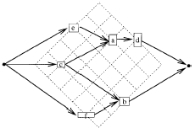
Horizontal-Constraint Graph
horizontal-constraint graph, G_{H}
Vertex Weight: 0 for s and t, width of module x for the other vertices

Slide 12
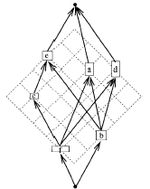
Vertical-Constraint Graph
vertical-constraint graph, G_{H}
Vertex Weight: 0 for s and t, height of module x for the other vertices

Slide 13
Longest Path Algorithm for vertex-weighted DAGs
no directed cycles means no two modules overlap each other
any pair of modules are either in horizontal or vertical relation
The width and height of the chip is determined by the longest path length between the source and the sink in G_{H} and G_{V}, respectively. Use the longest path algorithm for vertex weighted DAGs (O(m²) time for each constraint graph).

Slide 14
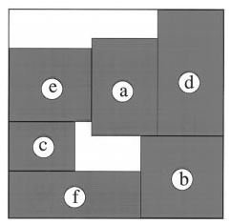
Optimal Packing
Optimal packing under the constraint implied by (Γ+,Γ-) = (ecadfb, fcbead)

Slide 15
P-admissible Solution Space
The set of all sequence-pairs is a P-admissible solution space of RP.
  (m!)² sequence-pairs
  each mapped to a packing in O(m²) time
  one is an optimal solution of RP
Any evaluating function that is independently non-decreasing with respect to the width and the height of the chip can be used.
  Area of the chip
  Perimeter of the chip
  Area of the chip of a pre-specified aspect ratio
  Height of chip with its width fixed
Fixed-module-orientation has been assumed. We can extend the described technique to “soft modules” by preparing candidates of (w,h) pairs per module. Furthermore, rotations and reflections can also be included. The size of the solution space increases by (m!)²X^{m}, where X is the number of possible pairs per module.

Slide 16
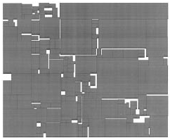
Rectangle Packing
Standard Simulated Annealing Method
  3 kinds of pair-interchange operations
    Two module names in Γ₊
    Two module names in both Γ₊ and Γ₋
    The width and the height of a module (orientation optimization)
  Initial sequence-pair is Γ₊ = Γ₋
  Temperature decreased exponentially
    Operation 1 selected with higher probability in higher temperature
    Operation 3 selected with higher probability in lower temperature
In an example of 146 modules
  606,192 of the possible (146!)²2¹⁴⁶ = 1.23x10⁵⁵² sequence-pairs were searched
  Sun SparcStationII reached terminating temperature in less than 30 minutes

Slide 17
O-Tree Representation Method
Motivation
  Simple representation of geometric relationship for non-slicing floorplan
  Satisfy cost function that includes area and amount of interconnect
Benefits of O-tree Representation
  Transformation between O-tree and constraint graph is O(n)
  Compaction included in structure (ie. one instance of O-tree maps to one placement)
  Can easily incorporate interconnect and area costs
  Fast deterministic algorithm for operation on O-Tree

Slide 18
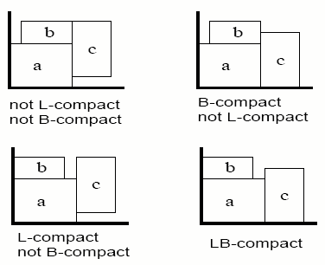
Admissible Placement
L-Compact: no block can shift left from its original position with other components fixed
B-Compact: no block can shift down from its original position with other components fixed
LB-Compact: placement that is both L-Compact and B-Compact
A placement is admissible if it is LB-Compact

Slide 19
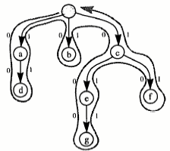
What is an O-tree?
A rooted directed tree in which the order of the subtrees T₁, T₂, …,T_{m} is important
Order of T₁, T₂, …,T_{m} determines order in DFS
To encode tree of n-nodes need:
  2(n-1)-bit string T to identify branching structure
  Permutation π of labels of n-nodes
Example: (T, π)
(00110100011011, adbcegf)

Slide 20
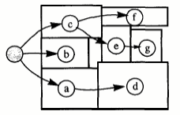
Horizontal O-tree
(00110100011011, adbcegf)
The root represents the left-boundary of the chip
Placement is always B-compact, but not necessary L-compact
Vertical O-tree is similar, but root is bottom of chip

Slide 21
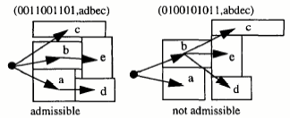
Admissible O-tree
O-tree is admissible if its corresponding placement is admissible
Lemma: Given an admissible O-tree, it is equal to the shortest path spanning tree embedded in the constraint graph of its corresponding placement
Corollary: Given an admissible placement, we can construct a horizontal constraint graph. The shortest path spanning tree is the horizontal O-tree of the placement (Also applies to vertical placement)

Slide 22
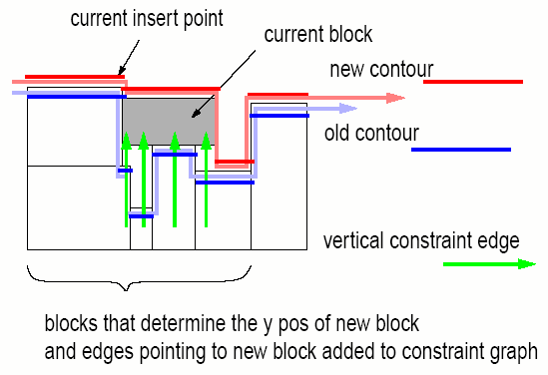
O-Tree to Constraint Graph
Use DFS and maintain contour structure to build orthogonal constraint graph from O-tree
Contour structure is double linked list which describes the contour line in current direction

Slide 23
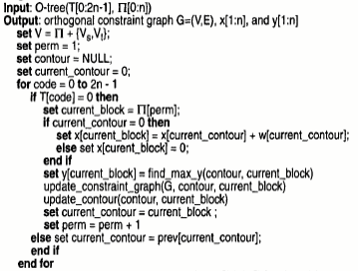
Algorithm OT2OCG

Slide 24
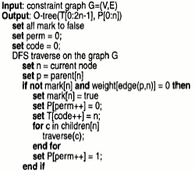
Algorithm CG2OT

Slide 25
Admissible O-tree Transformation (AOT)
Construct admissible O-tree by iteratively invoking OT2OCG and CG2OT
  Given a horizontal O-tree, construct vertical constraint graph G_{y} by OT2OCG
  Because is G_{y} B-Compact, use CG2OT to get vertical O-Tree
  Repeat steps above to vertical O-tree
  All moves are monotone (either move down or left)
  Converge to admissible O-tree

Slide 26
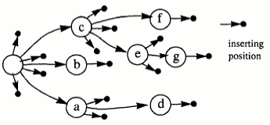
Floorplanning Using O-tree
Starting with a tree,
  Select block B_{i} in the tree
  Delete B_{i} from O-tree
  Insert B_{i} in the position with the best cost function
  Get admissible O-tree from AOT algorithm
  If cost function of the new tree is better than that of the old tree function, set tree to the new tree
  Repeat above steps

Slide 27



GPE: A New Representation for VLSI Floorplan Problem
B A *
B A *
B A * E @ C + D @
Generalized polish notation utilization of dead area
Notes:
Gpe uses sequence of modules to reflect physically non-slicing floorplan
@ = corner operator, arranges modules or super-module in a corner formed bty the other modules

Slide 28
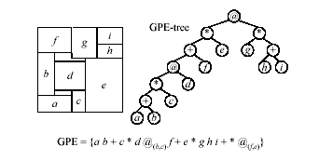
GPE Tree and GPE Corresponding to Packing
Exact position of corner operator @ determined by corner constraint, (R,T), where R is the right boundary left to the packed module and T is the top boundary below the packed module
Corner module may have many corner constraints, choose the one based on
  1. The associated module can be completely filled into the corner
  2. Putting the module into the corner does not enlarge floorplan

Slide 29
Valid GPE’s
Definition: A binary sequence b₁b₂…b_{m} is a balloting sequence if and only if, for any k, 1 ≤ k ≤ m, the number of 0’s in b₁b₂…b_{k} is less than the number of 1’s in b₁b₂…b_{k}. Let σ be a function σ: {1,2,…n,+,*,@} -> {0,1} defined by σ(i) = 1, where 1 ≤ i ≤ n, and σ(+) = σ(*) = σ(@) = 0.
A sequence Ψ = {λ₁, λ₂, …, λ_{2n-1}} of elements from {1,2,…n,+,*,@} is a GPE of length 2n-1 if and only if,
  1. Each i appears exactly once in the sequence, where 1 ≤ i ≤ 2n-1.
  2. σ(λ₁) σ(λ₂)… σ(λ_{2n-1}) is a balloting sequence

Slide 30
Valid GPE Moves
1. Complement
  Given chain d1d2…dq of length q, complement operation changes chain of original relational operators of nonzero length to the others. Ex. {*-*} -> {+-@}
2. Rotate
  Exchanges width and height of ith leaf on GPE-tree
3. Swap
  Randomly swap two leaves n_{i} an n_{j}
  Swap one leaf n_{i} and one sub-tree s_{j}
  Swap two sub-trees s_{i} and s_{j}

Slide 31
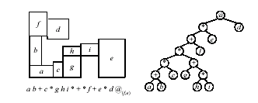
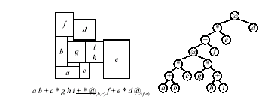
Valid GPE Moves Ex.
Initial GPE Configuration
Complement *+* -> +*@

Slide 32
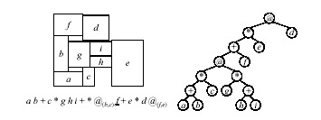
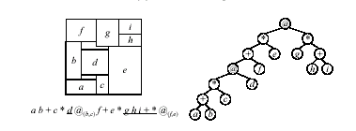
Valid GPE Moves Ex. (cont.)
Rotate module f
Swap subtree ghi+ and
module d

Slide 33
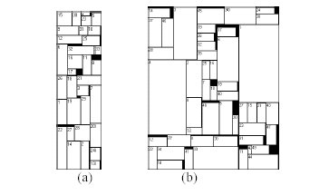
Final Circuit Layout Results
ami33
ami49

Slide 34
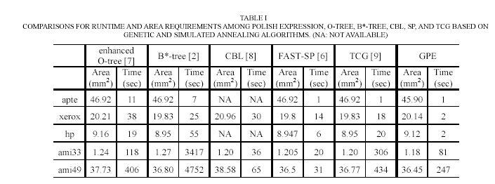
Results
GPE achieves promising area utilization compared to previous FAST-SP and Enhance O-Tree

Slide 35
Summary
Non-slicing floorplanning provides a more optimal layout than floorplanning with slicing.
However, it requires more complex representations for the layout
  Sequence-Pair
  O-tree
  GPE
Other representations include:
  enhanced o-tree, FAST-SP

Slide 36
References
H. Murata, K. Fujiyoshi, S. Nakatake, Y. Kajitani, “VLSI Module Placement Based on Rectangle-Packing by the Sequence-Pair,” In IEEE Transactions on Computer-Aided Design of Integrated Circuits and Systems, Vol. 15, No. 12, December 1996.
P.N. Guo, C.K. Cheng, and T. Yoshimura, " An O-Tree Representation of Nonslicing Floorplan and Its Applications,” ACM/IEE Design Automation Conf. pp. 268-273, June 1999.
C.T. Lin, D.S. Chen, and Y.W. Wang, “GPE: A New Representation for VLSI Floorplan Problem,” Proc. ICCD, pp42-44, 2002.

